Slide 1
DATA MINING AND ANALYSIS COURSE PROJECT
PREDICTING BRAIN DEEP SLEEP OSCILLATION
Team : D14
Project ID: P12
TEAM MEMBERS:
Shreedevi olekar 01FE17BCS193
Siri kini 01FE17BCS205
Soujanya R 01FE17BCS209
Soujanya H 01FE17BCS210

Slide 2

Introduction and duration
Normally sleep is measured in laboratory by attaching electrodes in the head.
Sleep is measured by EEG(ElectroEncyclography),EMG(Electromyography),EOG(eye movement). These procedure is called polysomnography (PSG) and allows to analyze the state of the patient during sleep.
It also allows to track sleep related disease.
Context :
In this challenge, data consists on EEG signals acquired on the Dreem headband in sham condition i.e. without any kind of sound stimulations. Thus we aim to predict brain activity in normal condition.
In this dataset, we try to predict whether or not a slow oscillation will be followed by another one in sham condition, i.e. without any stimulation.
Duration – from: 1-1-2019
to : 1-1-2020
By Dreem

Slide 3
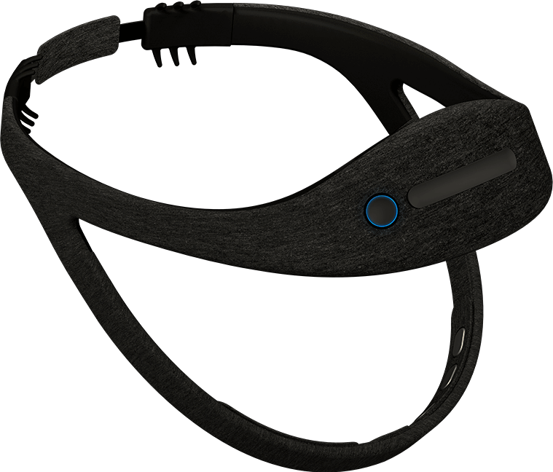
DREEM is a device used to measure the sleep at home. It is easy to use and more comfortable than normal PSG.
Its aims to help people track and improve their sleep.
The Dreem headband uses three kind of sensors:
EEG electrodes
Accelerometer
pulse oximeter
Hence, it is able to measure brain activity, position, respiration, heartrate and movement all along the night. The device is also able to send sounds using bone conduction. Signals are analyzed.

Slide 4
THE DATASET DESCRIPTION
Training data
Rows 261634
Columns 12
Each sample represents 10 seconds of recording starting 10 seconds before the end of a slow oscillation. Data provided consists of a N x 1261 matrix

Slide 5
Understanding the data
The dataset is in .h5 format.
The dataset is viewed in jupyter notebook by importing NumPy and pandas.
The dataset contains 12 columns(attributes) and their names were specified in .h5.
The features given in the challenge data description were the attributes.
We explicitly added the attribute names using list according to the features given.

Slide 6
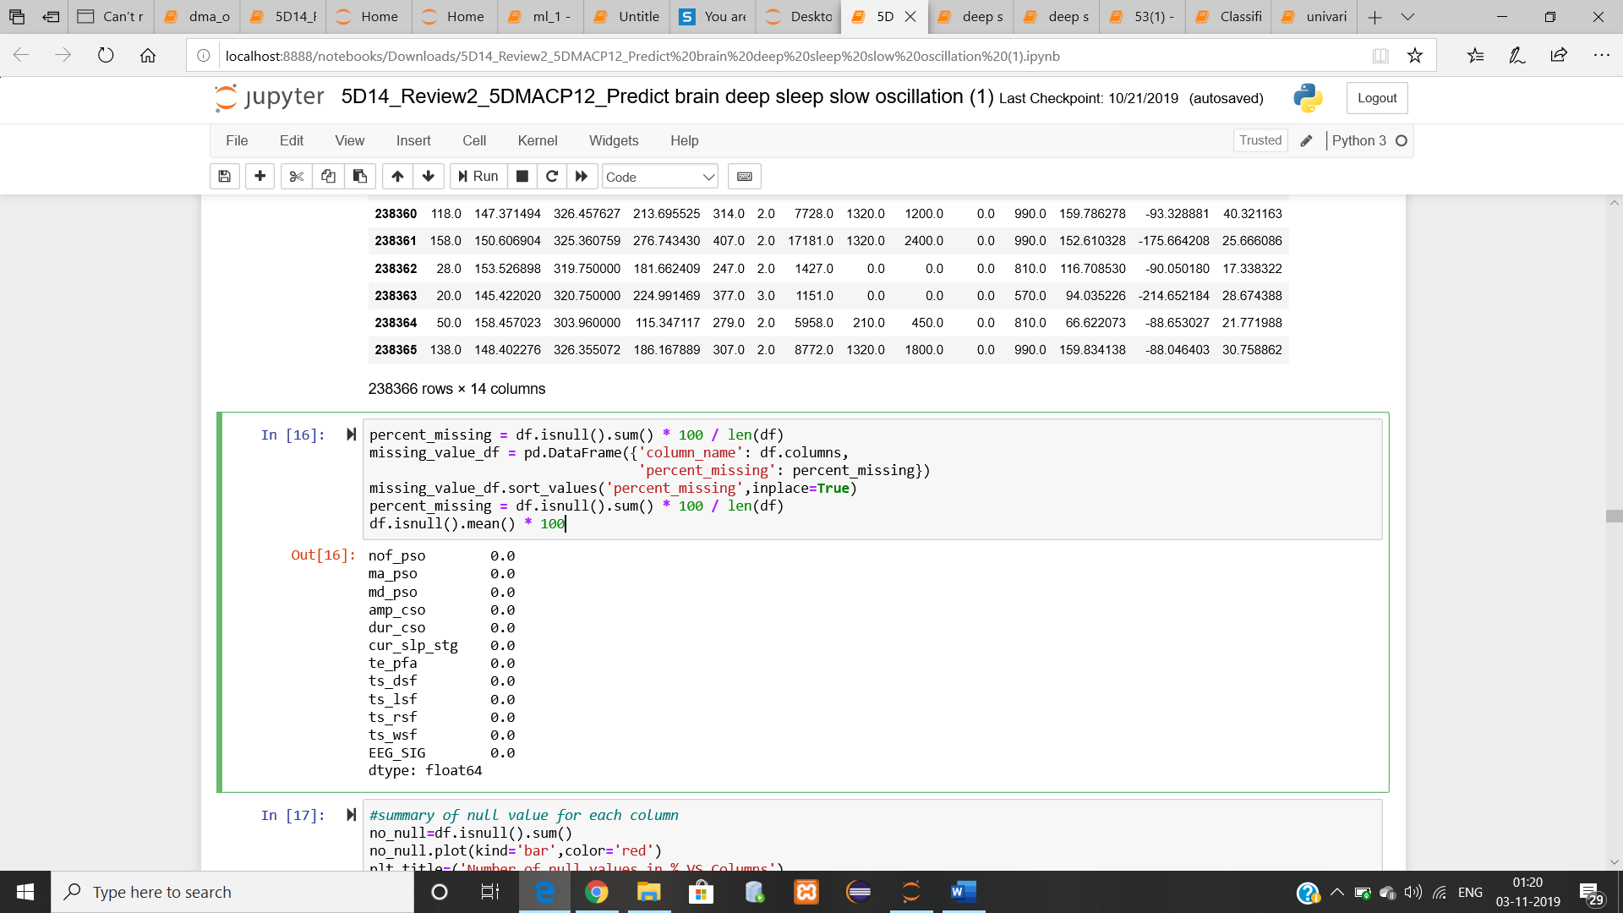
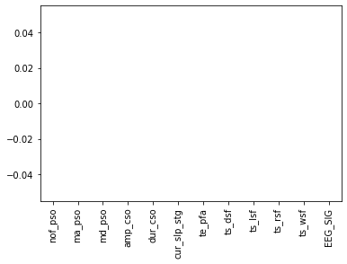
Data preprocessing
3.1 Pre-processing
The data has to be pre-processed before it can be fed to any learning model.
For pre-processing the following steps were taken:
There are no null values in each column.
Fig 1.0 - NULL values in attributes
fig2.0 graph of nullvalues

Slide 7
FEATURES
Number of previous oscillations
Mean amplitude of previous slow oscillations
Mean duration of previous slow oscillations
Amplitude of the current slow oscillation
Duration of the current slow oscillation
Current Sleep stage
Time elapsed since the person fell asleep
Time spent in deep sleep so far
Time spent in light sleep so far
Time spent in rem sleep so far
Time spent in wake sleep so far
to 1261. EEG signal for 10 seconds (sampling frequency: 125Hz -> 1250 data points)

Slide 8
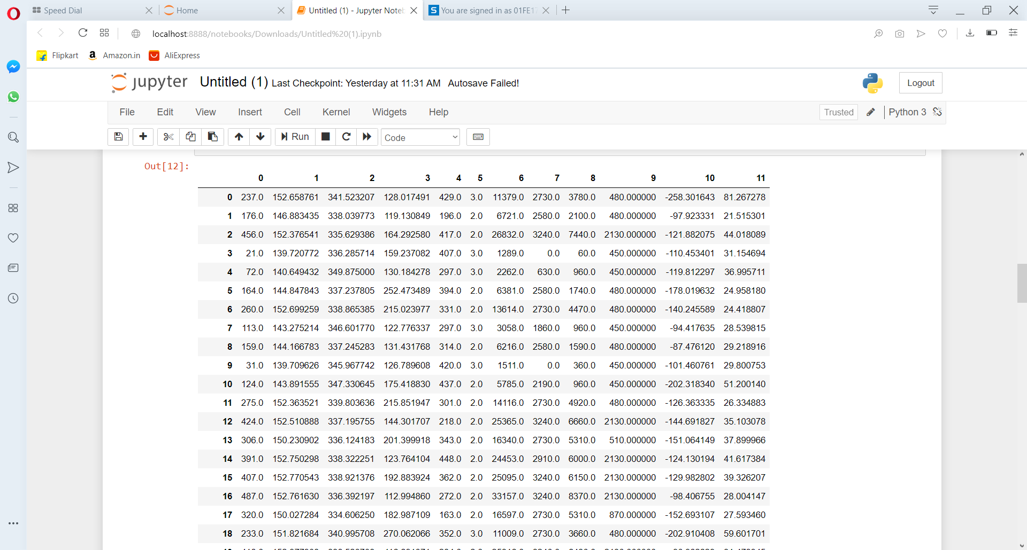

Slide 9
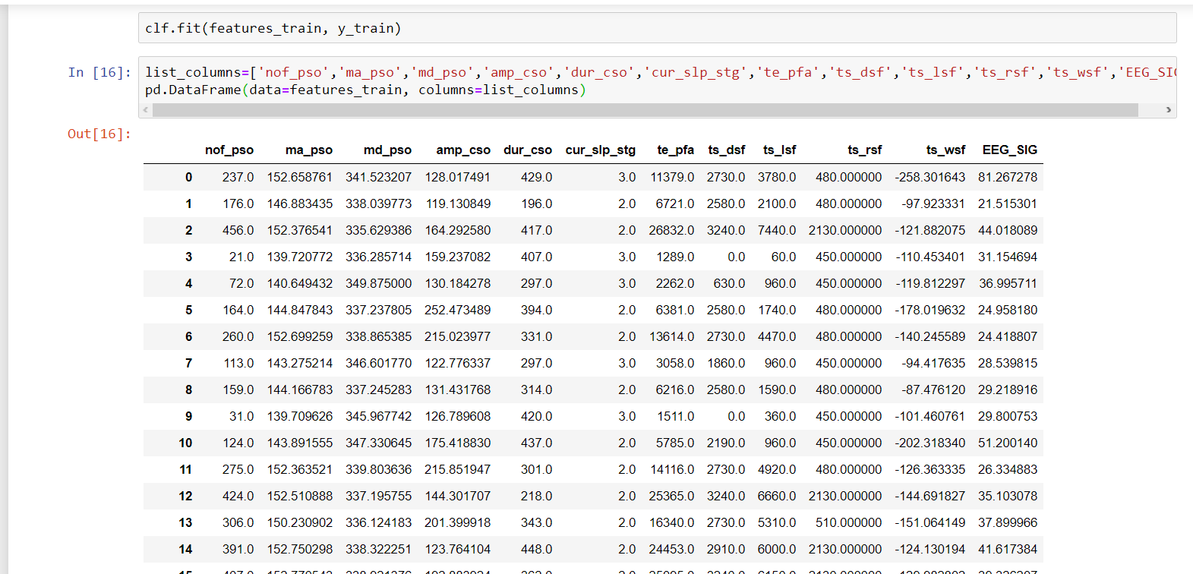

Slide 10
Data Reduction
The attributes were selected based on the features given in Data Description in the challenge. From column 12. to 1261. Columns were on EEG signal for 10 seconds.
Outliers
After complete data exploration outliers were found in some attributes and those were replaced by median value of that attribute.

Slide 11
Learning models
Model 1: Decision Tree
Model 2: Random forest classifier
Model 3: Naïve Bayes
Model 4: Lightgbm
Model 5:
Model 4:

Slide 12
Model 1: Decision Tree
Decision Trees (DTs) are a non-parametric supervised learning method used for classification and regression.
Decision trees tend to overfit on data with a large number of features.
Model accuracy is 0.541
Execution time is 00:00:20 .

Slide 13
Model 2: Random forest classifier
Random forest classifier creates a set of decision trees from randomly selected subset of training set.
It aggregates the votes from different decision trees to decide the final class of the test object.
accuracy after pre-processing is 1 which was overfitting .
Execution time is 00:20:00

Slide 14
Model 3: Naïve Bayes
Naive Bayes methods are a set of supervised learning algorithms based on applying Bayes’ theorem with the “naive” assumption of conditional independence between every pair of features given the value of the class variable.
accuracy is 0.3319.
Execution time is 00:10:00.

Slide 15
Model 4: Lightgbm
Light GBM grows tree vertically while other algorithm grows trees horizontally meaning that Light GBM grows tree leaf-wise while other algorithm grows level-wise.
accuracy is 0.541
Execution time is 00:00:20 .

Slide 16
CONCLUSION
Lightgbm Model accuracy is 0.541 and Execution time is 00:00:20 .
Random forest classifier accuracy after pre-processing is 1 which was overfitting . Execution time is 00:20:00
Decision tree accuracy is 0.3315. Execution time is 00:06:00
Naïve Bayes classification accuracy is 0.3319. Execution time is 00:10:00.
Since Lightgbm has higher efficiency as well as faster training speed, which givesBetter accuracy compared to other applied models and evenData of large-scale can be handled by Lightgbm in better way. We have considered Lightgbm.

Slide 17
Reference:
[1] https://dreem.com/en/headband
[2] https://challengedata.ens.fr/challenges/10

Slide 18
Thank you

